Slide 1
Non Deterministic Finite Automata with ε Transition (NFA- ε) Session 05
Course : Comp6062 – Compilation Techniques
Effective Period : September 2018

Slide 2
Learning Outcomes
At the end of this Session, the student will be expected to:
Identify or define NFA with ∈-transition
Converting of RE to NFA-Epsilon with Thomson’s Construction and Converting NFA-Epsilon to DFA

Slide 3
Outline Material
NFA with ∈-transition
Converting of RE to NFA-Epsilon (Thomson’s Construction)
Converting NFA-Epsilon to DFA
Converting RE to DFA

Slide 4
ε - NFA
Finite Automata with ∈-transition :
Allow transition on the input is empty (∈) from the state q.
Formal definition for NFA :
M = (Q, (∑ U {∈}), σ, q₀, F)
Q, ∑, q₀, F : same as FA
Transition Function :
σ : Q × (∑ ∪ {∈}) → Q
σ(q,a) : a may ∈ OR a ∈ ∑
Basis :
State q is in ECLOSE(q)
Induction :
If state p in ECLOSE(q), and there is a transition from p to r labeled by ∈, then state r is in ECLOSE(q)

Slide 5
ε - NFA
Language Accepted :
L accepted by NFA with ∈-transition : L(M) = {w⎮σ(q₀,w) in F}
Example :
Consider ε-NFA accepting decimal numbers, consisting of sign (+/-), digit, decimal point dan digit. One of the digit may empty
0,1,…,9
0,1,…,9
ε, +, -
.
Start
q0
q1
q2
q3
ε
q5
0,1,…,9
0,1,…,9
.
q4

Slide 6
ε - NFA
compute string 5.6
σ(q0, ε) = ECLOSE(q0) = {q0,q1}
σ(q0, 5) = σ(q0,5) U σ (q1,5) = {q1,q4}
= ECLOSE(q1) U ECLOSE(q4)
= {q1,q4}
σ(q0, 5.) = σ(q1, .) U σ(q4, .) = {q2,q3}
= ECLOSE(q2) U ECLOSE(q3)
={q2,q3,q5}
σ(q0, 5.6) = σ(q2,6) U σ(q3,6) U σ(q5,6)
= {q3} = ECLOSE(q3)
= {q3,q5} ➔ Accepted

Slide 7
Theorem :
If L is accepted as NFA with
∈-transition, then L is accepted by NFA without ∈-Transition.
Every NFA- ∈ can find an equivalent NFA
Every NFA- ∈ can find an equivalent DFA

Slide 8
Converting ε - NFA to DFA
Let ε- NFA E = (Q_{E}, ∑, σ_{E}, q₀, F_{E})
Then the equivalent DFA A = (Q_{D}, ∑, σ_{D},{q_{D}}, F_{D}) is define as followed :
Q_{D} is the set of subset Q_{E}.
q_{D} = ECLOSE(q0)
F_{D} is those sets of states that contains at least one accepting state of E
σ_{D}(S,a) is computed for all a in ∑ and sets S in Q_{D}, by :
a. Let S = {p1,p2,p3,…pk}
b. Compute U^{k}_{i=1} σ_{E}(Pi,a) let this set be {r1,r2,r3,…rm)
c. Then σ_{D}(S,a) = U^{m}_{j=1} ECLOSE(Rj)

Slide 9
Converting ε - NFA to DFA
Example from ε – NFA above :
Start State in E = q0, Start State in D = ECLOSE(q0) Start State in D = {q0,q1}
σ({q0,q1},+) = {q1} → ECLOSE(q1) = {q1}
σ({q0,q1},+) = {q1}
σ({q0,q1},-) = {q1} → ECLOSE(q1) = {q1}
σ({q0,q1},-) = {q1}
σ({q0,q1},.) = {q2} → ECLOSE(q2) = {q2}
σ({q0,q1},.) = {q2}
σ({q0,q1},0,1…,9) = {q1,q4} → ECLOSE(q1,q4) = {q1,q4}
σ({q0,q1},0,1…,9) = {q1,q4}

Slide 10
Converting ε - NFA to DFA
σ({q1},.) = {q2} → ECLOSE(q2) = {q2}
σ({q1},.) = {q2}
σ({q1},0,1,...,9) = {q1,q4} → ECLOSE(q1,q4) = {q1,q4}
σ({q1},0,1,...,9) = {q1,q4}
8. σ({q2},0,1,...,9) = {q3} → ECLOSE(q3) = {q3,q5}
σ({q2},0,1,...,9) = {q3,q5}
σ({q1,q4},0,1,...,9) = {q1,q4} → ECLOSE(q1,q4) = {q1,q4}
σ({q1,q4},0,1,...,9) = {q1,q4}

Slide 11
Converting ε - NFA to DFA
10. σ({q1,q4},.) = {q2,q3} → ECLOSE(q2,q3) = {q2,q3,q5}
σ({q1,q4},.) = {q2,q3,q5}
11. σ({q3,q5},0,1,…,9) = {q3} → ECLOSE(q3) = {q3,q5}
σ({q3,q5},0,1,…,9) = {q3,q5}
12. σ({q2,q3,q5},0,1,...,9) = {q3} → ECLOSE(q3) = {q3,q5}
σ({q2,q3,q5},0,1,...,9) = {q3,q5}

Slide 12
Converting ε - NFA to DFA
0,1,…,9
0,1,…,9
Start
{q0,q1}
+, -
{q1}
{q1,q4}
.
{q2,q3,q5}
0,1,…,9
.
0,1,…,9
.
{q2}
0,1,…,9
{q3,q5}
0,1,…,9

Slide 13
Converting a NFA into a DFA (Example)
2
a
3
ε
ε
0
ε
1
ε
a
ε
6
7
8
ε
4
b
5
ε
S₀ = ε-closure({0}) = {0,1,2,4,7} S₀ into DS as an unmarked state
⇓ mark S₀
ε-closure(move(S₀,a)) = ε-closure({3,8}) = {1,2,3,4,6,7,8} = S₁ S₁ into DS
ε-closure(move(S₀,b)) = ε-closure({5}) = {1,2,4,5,6,7} = S₂ S₂ into DS
transfunc[S₀,a] ⬅ S₁ transfunc[S₀,b] ⬅ S₂
⇓ mark S₁
ε-closure(move(S₁,a)) = ε-closure({3,8}) = {1,2,3,4,6,7,8} = S₁
ε-closure(move(S₁,b)) = ε-closure({5}) = {1,2,4,5,6,7} = S₂
transfunc[S₁,a] ⬅ S₁ transfunc[S₁,b] ⬅ S₂
⇓ mark S₂
ε-closure(move(S₂,a)) = ε-closure({3,8}) = {1,2,3,4,6,7,8} = S₁
ε-closure(move(S₂,b)) = ε-closure({5}) = {1,2,4,5,6,7} = S₂
transfunc[S₂,a] ⬅ S₁ transfunc[S₂,b] ⬅ S₂

Slide 14
Converting a NFA into a DFA (Example – cont.)
S₀ is the start state of DFA since 0 is a member of S₀={0,1,2,4,7}
S₁ is an accepting state of DFA since 8 is a member of S₁ = {1,2,3,4,6,7,8}
a
S₁
a
S₀
b
a
b
S₂
b

Slide 15
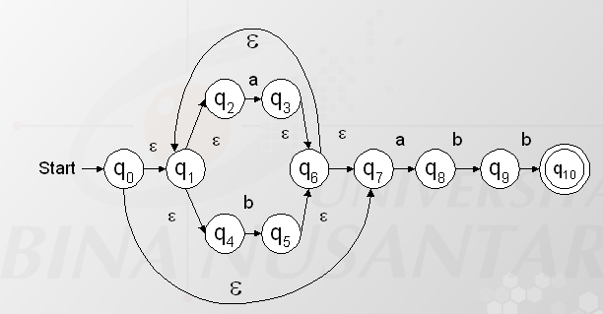
Konversi NFA ke DFA
Converting ε - NFA to DFA
ε-closure (0) = {0,1,2,4,7}
ε-closure (1) = {1,2,4,}
ε-closure (2) = {2,}
ε-closure (3) = {1,2,3,4,6,7}
ε-closure (4) = {4}
ε-closure (5) = {1,2,4,5,6,7}
ε-closure (6) = {1,2,4,6,7}
ε-closure (7) = {7,}
ε-closure (8) = {8}
ε-closure (9) = {9,}
ε-closure (10) = {10,}
State DFA hasil konversi :
Start state = ε-closure (0) = {0,1,2,4,7} = state 0
Yang bisa diinputkan a dari state 0 = {2,7}
(0,a) = ε-closure ({3,8}) = {1,2,3,4,6,7,8} = state 1
Yang bisa diinputkan b dari stae 0 = {4}
(0,b) = ε-closure ({5}) = {1,2,4,5,6,7} = state 2
State 1 = {1,2,3,4,6,7,8}
Yang bisa diinputkan a dari state 1 = {2,7}
(1,a) = ε-closure ({3,8}) = {1,2,3,4,6,7,8} = state 1
Yang bisa diinputkan b dari state 1 = {4,8}
(1,b) = ε-closure ({5,9}) = {1,2,4,5,6,7,9} = state 3

Slide 16
Converting ε - NFA to DFA
State DFA hasil konversi :
State 2 = {1,2,4,5,6,7}
Yang bisa diinputkan a dari state 2 = {2,7}
(2,a) = ε-closure ({3,8}) = {1,2,3,4,6,7,8} = state 1
Yang bisa diinputkan b dari stae 2 = {4}
(2,b) = ε-closure ({5}) = {1,2,4,5,6,7} = state 2
State 3 = {1,2,4,5,6,7,9}
Yang bisa diinputkan a dari state 3 = {2,7}
δ(3,a) = ε-closure ({3,8}) = {1,2,3,4,6,7,8} = state 1
Yang bisa diinputkan b dari stae 3 = {4,9}
δ(3,b) = ε-closure ({5,10}) = {1,2,4,5,6,7,10} = state 4
State 4 = {1,2,4,5,6,7,10} = finalnya krn mengandung state 10 yang merupakan final state NFA asalnya
Yang bisa diinputkan a dari state 4 = {2,7}
δ(4,a) = ε-closure ({3,8}) = {1,2,3,4,6,7,8} = state 1
Yang bisa diinputkan b dari stae 4 = {4}
δ(4,b) = ε-closure ({5}) = {1,2,4,5,6,7} = state 2
ε-closure (0) = {0,1,2,4,7}
ε-closure (1) = {1,2,4,}
ε-closure (2) = {2,}
ε-closure (3) = {1,2,3,4,6,7}
ε-closure (4) = {4}
ε-closure (5) = {1,2,4,5,6,7}
ε-closure (6) = {1,2,4,6,7}
ε-closure (7) = {7,}
ε-closure (8) = {8}
ε-closure (9) = {9,}
ε-closure (10) = {10,}

Slide 17
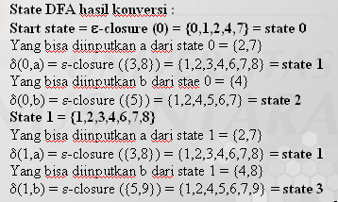
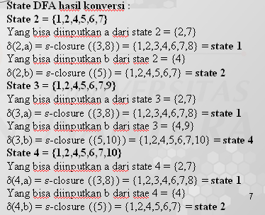
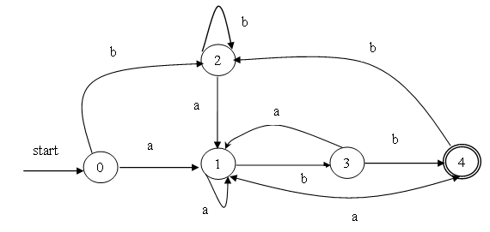
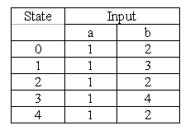
Tabel Transisi & diagram DFA
Converting ε - NFA to DFA

Slide 18



Conversion of RE to NFA-Epsilon
Theorem :
Every Regular Expression R can be made NFA- ε Machine, so that L(M) = L(R).
Evidence :
R = ∅
2. R = ε
3. R = a

Slide 19
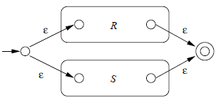

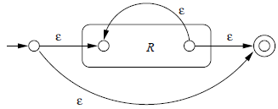
3. RE : R+S
4. RE : R.S
5. RE : R*

Slide 20
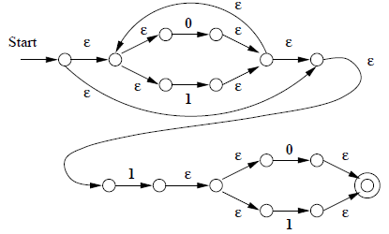
Example : Make NFA- ε for RE : (0+1)*1(0+1)
answer:

Slide 21
Thomson’s Construction (Example : (a|b) * a )
a:
a
a
ε
(a | b)
ε
b
ε
ε
b:
b
ε
a
ε
ε
(a|b) *
ε
ε
ε
ε
b
ε
ε
a
ε
ε
(a|b) * a
ε
ε
a
ε
ε
b
ε

Slide 22
Converting Regular Expressions Directly to DFAs
We may convert a regular expression into a DFA (without creating a NFA first).
First we augment the given regular expression by concatenating it with a special symbol #.
r ➔ (r)# augmented regular expression
Then, we create a syntax tree for this augmented regular expression.
In this syntax tree, all alphabet symbols (plus # and the empty string) in the augmented regular expression will be on the leaves, and all inner nodes will be the operators in that augmented regular expression.
Then each alphabet symbol (plus #) will be numbered (position numbers).

Slide 23
Regular Expression ➔ DFA (cont.)
(a|b) * a ➔ (a|b) * a # augmented regular expression
•
Syntax tree of (a|b) * a #
each symbol is numbered (positions)
each symbol is at a leave
inner nodes are operators
•
#
4
*
a
3
|
a
b
1
2

Slide 24
firstpos, lastpos, nullable
To evaluate followpos, we need three more functions to be defined for the nodes (not just for leaves) of the syntax tree.
firstpos(n) -- the set of the positions of the first symbols of strings generated by the sub-expression rooted by n.
lastpos(n) -- the set of the positions of the last symbols of strings generated by the sub-expression rooted by n.
nullable(n) -- true, if the empty string is a member of strings generated by the sub-expression rooted by n false otherwise

Slide 25
How to evaluate firstpos, lastpos, nullable
n | nullable(n) | firstpos(n) | lastpos(n)
leaf labeled ε | true | Φ | Φ
leaf labeled with position i | false | {i} | {i}
 | nullable(c₁) or nullable(c₂) | firstpos(c₁) ∪ firstpos(c₂) | lastpos(c₁) ∪ lastpos(c₂)
 | nullable(c₁) and nullable(c₂) | if (nullable(c₁)) firstpos(c₁) ∪ firstpos(c₂) else firstpos(c₁) | if (nullable(c₂)) lastpos(c₁) ∪ lastpos(c₂) else lastpos(c₂)
 | true | firstpos(c₁) | lastpos(c₁)
|
C1 C2
•
C1 C2
*
|
C1

Slide 26
Example – firstpost & lastpos
{1,2,3}
•
{4}
( a | b) * a #
1 2 3 4
{1,2,3}
•
{3}
{4}
#
{4}
4
{1,2}
{1,2}
{3}
*
{3}
a
3
{1,2}
|
{1,2}
{1}
a
{1}
{2}
b
{2}
1
2
Firstpos – Warna biru
Lastpos – Warna merah

Slide 27
followpos
Then we define the function followpos for the positions (positions assigned to leaves).
followpos(i) :
is the set of positions which can follow the position i in the strings generated by the augmented regular expression.

Slide 28
How to evaluate followpos
Two-rules define the function followpos:
If n is concatenation-node with left child c₁ and right child c₂, and i is a position in lastpos(c₁), then all positions in firstpos(c₂) are in followpos(i).
If n is a star-node, and i is a position in lastpos(n), then all positions in firstpos(n) are in followpos(i).
If firstpos and lastpos have been computed for each node, followpos of each position can be computed by making one depth-first traversal of the syntax tree.

Slide 29
Example -- ( a | b) * a #
{1,2,3}
•
{4}
Then we can calculate followpos
followpos(1) = {1,2,3}
followpos(2) = {1,2,3}
followpos(3) = {4}
followpos(4) = {}
{1,2,3}
•
{3}
{4}
#
{4}
4
{1,2}
{1,2}
*
{3}
a
{3}
3
{1,2}
|
{1,2}
{1}
a
{1}
{2}
b
{2}
1
2
After we calculate follow positions, we are ready to create DFA for the regular expression.

Slide 30
Algorithm (RE ➔ DFA)
Create the syntax tree of (r) #
Calculate the functions: followpos, firstpos, lastpos, nullable
Put firstpos(root) into the states of DFA as an unmarked state.
while (there is an unmarked state S in the states of DFA) do
mark S
….

Slide 31
Algorithm (RE ➔ DFA)
for each input symbol a do
let s₁,...,s_{n} are positions in S and symbols in those positions are a
S’ ⬅ followpos(s₁) ∪ ... ∪ followpos(s_{n})
move(S,a) ⬅ S’
if (S’ is not empty and not in the states of DFA)
put S’ into the states of DFA as an unmarked state.
the start state of DFA is firstpos(root)
the accepting states of DFA are all states containing the position of #

Slide 32
Example - 1
( a | b) * a #
1 2 3 4
followpos(1)= {1,2,3} followpos(2)={1,2,3}
followpos(3)= {4} followpos(4)={}
S₁=firstpos(root)={1,2,3} →
⇓ mark S₁
a: followpos(1) ∪ followpos(3)={1,2,3,4}=S₂ move(S₁,a)=S₂
b: followpos(2)={1,2,3}=S₁ move(S₁,b)=S₁

Slide 33
Example – 1 – cont…
⇓ mark S₂
a: followpos(1) ∪ followpos(3)={1,2,3,4}=S₂ move(S₂,a)=S₂
b: followpos(2)={1,2,3}=S₁ move(S₂,b)=S₁
start state: S₁
accepting states: {S₂}
b
a
a
S₁
S₂
b

Slide 34
Converting Regular Expressions Directly to DFAs
We may convert a regular expression into a DFA (without creating a NFA first).
First we augment the given regular expression by concatenating it with a special symbol #.
r ➔ (r)# augmented regular expression
Then, we create a syntax tree for this augmented regular expression.
In this syntax tree, all alphabet symbols (plus # and the empty string) in the augmented regular expression will be on the leaves, and all inner nodes will be the operators in that augmented regular expression.
Then each alphabet symbol (plus #) will be numbered (position numbers).

Slide 35
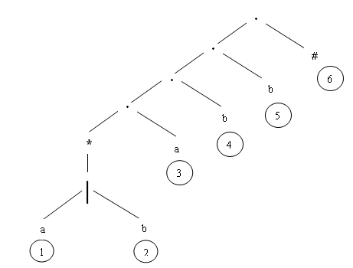
Contoh konversi RE ke DFA langsung
Re = (a|b)*abb tambahkan # menjadi
(a|b)*abb # → buat pohon syntaxnya sbb :

Slide 36
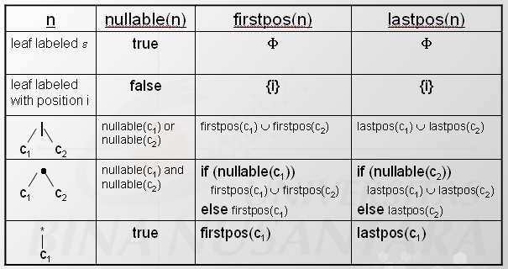
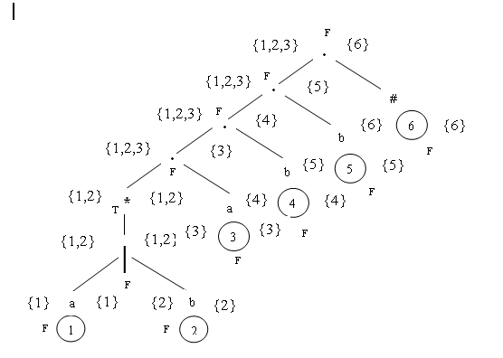
Contoh konversi RE ke DFA langsung
Tentukan nullable, firstpos,lastpos berdasarkan aturan yg terdapat dlm table berikut

Slide 37
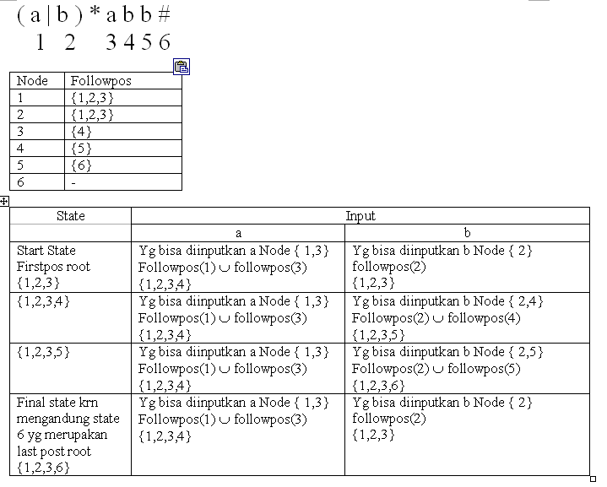
Contoh konversi RE ke DFA langsung
Tentukan followpos setiap node

Slide 38
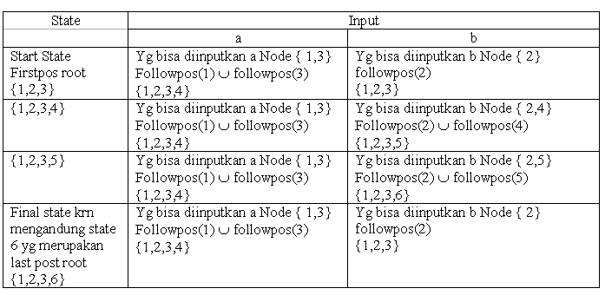
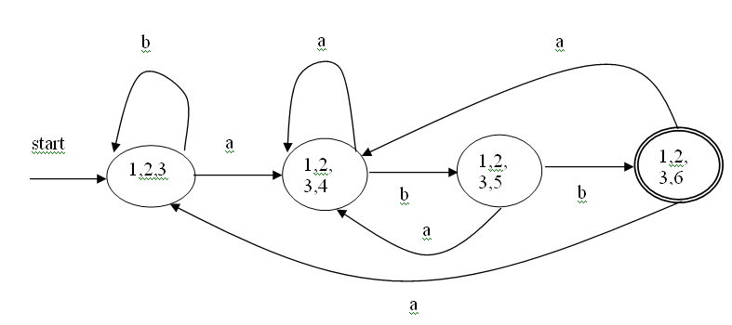
Contoh konversi RE ke DFA langsung

Slide 39
( a | ε) b c* #
Example
1 2 3 4
followpos(1)= {2} followpos(2)={3,4}
followpos(3)= {3,4} followpos(4)={}
S₁=firstpos(root)={1,2}
⇓ mark S₁
a: followpos(1)={2}=S₂ move(S₁,a)=S₂
b: followpos(2)={3,4}=S₃ move(S₁,b)=S₃

Slide 40
Example – Cont..
⇓ mark S₂
b: followpos(2)={3,4}=S₃ move(S₂,b)=S₃
⇓ mark S₃
c: followpos(3)={3,4}=S₃ move(S₃,c)=S₃
start state: S₁
accepting states: {S₃}
S₂
a
b
S₁
b
S₃
c

Slide 41
Exercises
Convert the following ε-NFA to DFA :
Convert the following RE directly to DFA
(a | b)* (ab | bb) a
State | ε | a | b | c
P | - | P | Q | R
Q | P | Q | R | -
*R | Q | R | - | P

Slide 42
References
Hopcroft, John E., Motwani, Rajeev, Ullman, Jeffrey D. (2007). Introduction to automata theory, languages, and computation. 3rd. Addison-Wesley. New York. ISBN: 9780321476173, Chapter 2.5 (page 72-80), 3.1 and 3.2 (page 83 -106)
Aho, A.V., Ravi, S., & Ullman, J.D. (2007). Compiler : Principle, techniques and tools. 2nd. Addison-Wesley. New York. ISBN : 0321491696, Chapter 3.7 (page 152-166)
http://www.cs.rit.edu/~jmg/courses/cs380/20041/slides/NFAe.pdf

